Slide 1
FROM MODEL DIFFS TO CAUSAL MECHANISMS
The case
The model solved the task—then kept writing.
Using a CrossCoder to explain behavioral differences between base and fine-tuned code models
A single latent feature helped control that continuation.
DSTK100 · preliminary causal model diffing
1
Notes:
Open with the behavioral paradox, not the architecture. The scientific question is whether a shared sparse representation can explain why the models diverge.

Slide 2
RESEARCH QUESTION
The evaluation tells us what changed. The CrossCoder asks why.
BEHAVIOR
REPRESENTATION
●
Base passes / fine-tuned fails
●
Paired layer-16 residuals
●
Base fails / fine-tuned passes
●
Shared sparse features
●
What kind of error occurred?
●
Decoder directions for intervention
Behavior localizes the difference. Features turn it into a testable hypothesis.
DSTK100 · preliminary causal model diffing
2

Slide 3
METHOD
First case study: DeepSeek base ↔ fine-tuned model diffing (DSTK100)
BASE
layer 16
same tokens
CROSSCODER
→
→
100 active features
16,384 latents ReLU + TopK 100
FINE-TUNED
per evaluated token
layer 16
2,608 code texts · 617,959 evaluated tokens · same-text alignment
Method Lineage
Based on Sparse Crosscoders for Cross-Layer Features and Model Diffing (Lindsey et al., 2024). TopK sparsity follows the sparse-autoencoder design studied by Gao et al. (2024). DSTK100 is our same-text, layer-16, TopK-100 implementation.
References
• Lindsey, J. et al. "Sparse Crosscoders for Cross-Layer Features and Model Diffing." Transformer Circuits, 2024.
• Gao, L. et al. "Scaling and Evaluating Sparse Autoencoders." 2024.
3

Slide 4
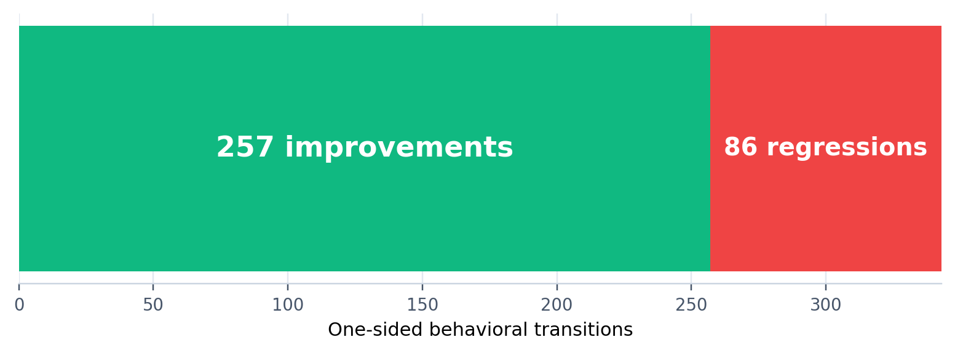
BEHAVIORAL MAP
Ours Results to DSTK100 agrees with ReCatcher
Agreement with ReCatcher
ReCatcher reported that Kotlin fine-tuning improved aggregate General Logic for DeepSeek-Coder, despite introducing localized regressions—particularly syntax errors.
ReCatcher · DeepSeek FT vs original
HumanEval+: +14.94% in Incorrect Code / General Logic
BigCodeBench: +9.32% in Incorrect Code / General Logic
Our paired evaluation
HumanEval+: +22.57 pp in pass rate
BigCodeBench: +7.19 pp in pass rate
Improvements outnumbered regressions by ~3:1 overall
* The magnitudes are not directly comparable: ReCatcher used 10 generations per prompt and its own regression-percentage definition; our study used one canonical generation per task and official paired evaluation.
Abbassi et al., ReCatcher: Towards LLMs Regression Testing for Code Generation, 2025.
343
One-Sided Transitions
Total instances where models diverged
257
Improvements
base fail → FT pass
HumanEval+: 42 BigCodeBench: 215
86
Regressions
base pass → FT fail
HumanEval+: 7 BigCodeBench: 79
DSTK100 · preliminary causal model diffing

Slide 5
FEATURE SCREENING
We ranked stable contrasts—not raw activation alone
4 summaries
Δ per task
Observed effect
200 permutations
E/V
→
→
→
→
max · early_max mean · active fraction
aggregate(FT text) − aggregate(base text)
mean Δ positives − mean Δ controls
shuffle labels; recompute effect
effect ÷ null SD
Minimum support
max(3 tasks, 10% of positives)
E/V is a permutation signal-to-noise score—not a z-score or a p-value.
DSTK100 · preliminary causal model diffing
6

Slide 6
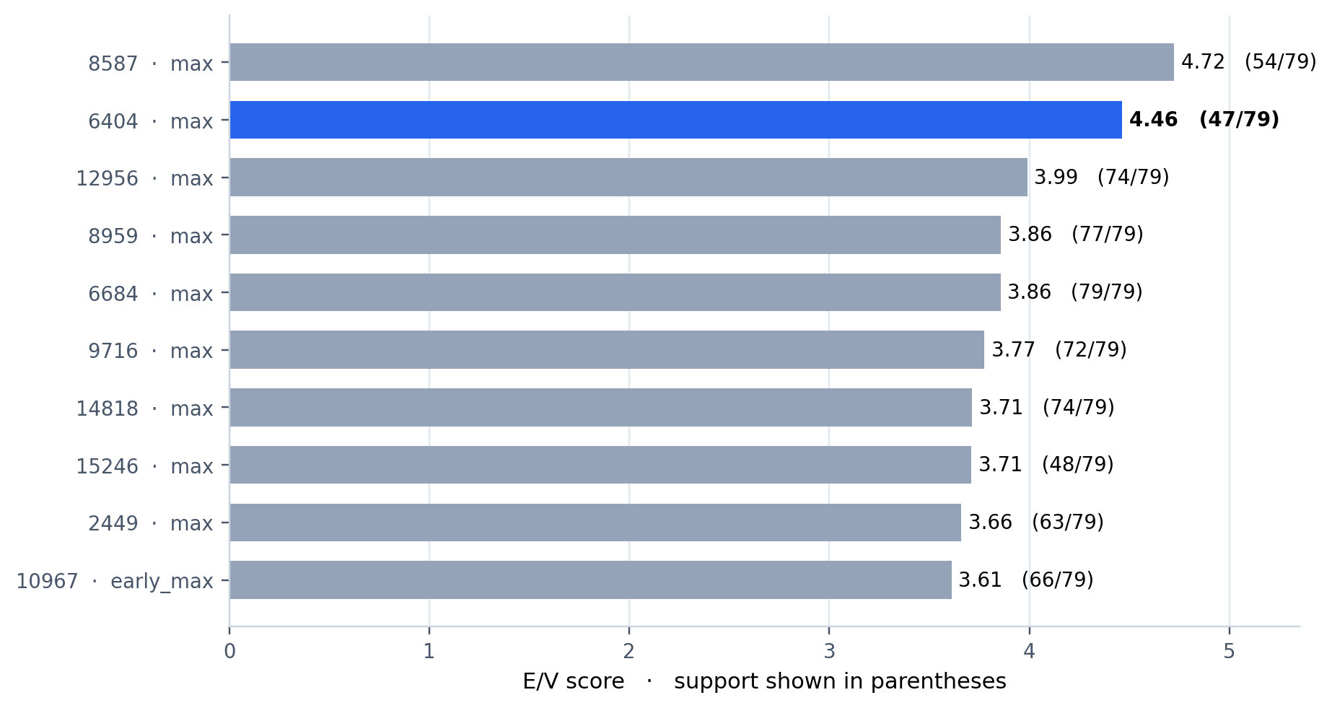
SCREENING RESULT
Feature 6404 ranked #2—and the result was specification-robust
6404
E/V 4.47
47 / 79 support
Same Top 10 with all four aggregations or E/V alone
DSTK100 · preliminary causal model diffing
7

Slide 7
SELECTION LOGIC
A good causal candidate aligns meaning, failure mode, and timing
MEANING
FAILURE MODE
TIMING
What tokens and contexts activate the feature?
Which behavioral transition is it associated with?
Does activation precede the relevant decision?
Semantic clarity alone is not enough: a late feature may be a consequence or style marker.
DSTK100 · preliminary causal model diffing
9

Slide 8
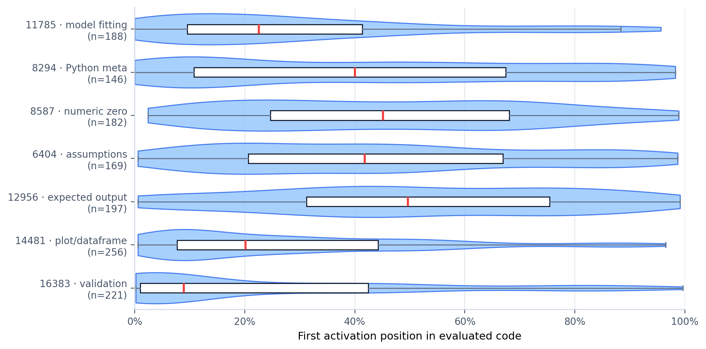
TEMPORAL PLAUSIBILITY
First-activation position separates plausible causes from late markers
Example
Feature 12956
Expected output / examples
Semantically clear—often too late to explain the implementation decision.
DSTK100 · preliminary causal model diffing
10

Slide 9
MECHANISTIC DISCOVERY
The pearl: many ‘improvements’ were simply cleaner stopping behavior
119 / 215
def task_func(...): ... plausible solution ... - -# tests -from task_func import task_func
BigCodeBench improvements
55%
test/import contamination in the base output
The fine-tuned model often won by stopping—not by implementing a different algorithm.
DSTK100 · preliminary causal model diffing
11

Slide 10
FEATURE INTERPRETATION
Feature 6404 matched the semantics of post-solution continuation
6404
67%
31%
vs
Dominant activation contexts
contamination cases
other improvements
expected
should
Exploratory odds ratio ≈ 4.44
assumptions / caveats
comments and boilerplate
Association generated the hypothesis; it did not establish causality.
DSTK100 · preliminary causal model diffing
12

Slide 11
CAUSAL DESIGN
A deliberately selected cohort turned the hypothesis into a test
1
2
3
4
Base failed
Fine-tuned passed
Base generated tests/imports
Feature 6404 was naturally active
80
mechanistic cases
Selected for mechanism—not an out-of-sample estimate.
DSTK100 · preliminary causal model diffing
13

Slide 12
ONLINE GATED STEERING
We intervened only when 6404 entered the natural TopK
Current token
→
Paired residuals
→
DSTK100
→
6404 active?
→
Next token
capture layer 16
RMS normalize
ReLU + TopK 100
gate intervention
continue generation
h′ₜ = hₜ + α · z₆₄₀₄,ₜ · RMS(hₜ) · d₆₄₀₄,base
The intervention changes the next-token distribution; it does not rewrite earlier tokens.
DSTK100 · preliminary causal model diffing
14

Slide 13
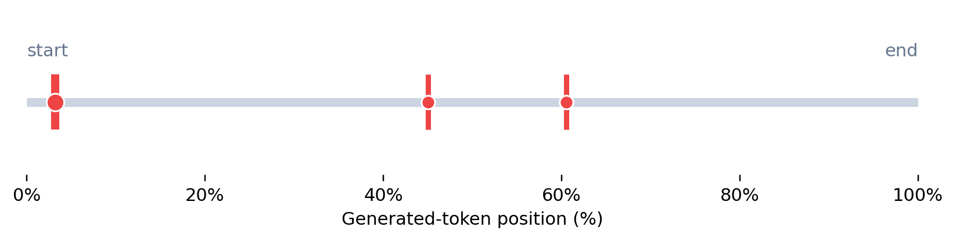
TOKEN-LEVEL CASE
One example: the baseline solved the task, then imported its own test
BASELINE · FAIL
6404 SUPPRESSION · PASS
return [] # tests/test_task_func.py import unittest from task_func import task_func
return min_subsequence # task_func({...}) # task_func({...})
The plausible function body is followed by test/import contamination.
Official pass; no generated test module import.
Red marks: online steps where feature 6404 entered the active TopK in the steered trajectory.
DSTK100 · preliminary causal model diffing
15
Notes:
Representative task: BigCodeBench/668. Show the exact full outputs in the appendix/source data if challenged; the slide uses a compact excerpt. Active gate steps were 8, 113, and 152 of 251 generated-token steps.

Slide 14
MAIN CAUSAL RESULT
The intervention recovered official passes—not just prettier text
19 / 80
41 / 80
fail → official pass
test/import contamination removed
α = −2 · TopK-gated · exact code evaluated with extraction v4
Cohort selected for this mechanism; do not read 23.75% as general benchmark gain.
DSTK100 · preliminary causal model diffing
16

Slide 15
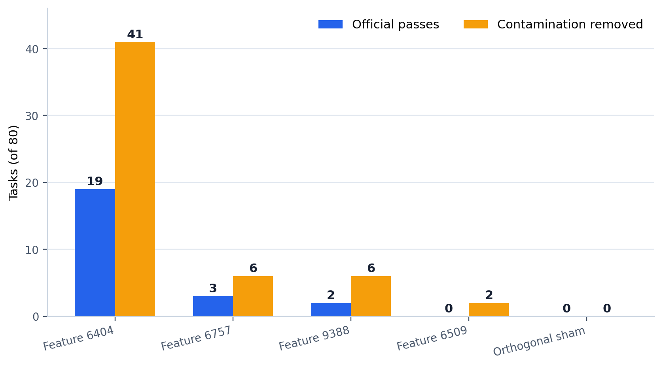
SPECIFICITY
Matched controls isolate the 6404 direction
Controls matched
●
decoder norm
●
activation support
●
temporal profile
●
online gate activity
vs sham
pass p ≈ 3.8×10⁻⁶ cleanup p ≈ 9.1×10⁻¹³
DSTK100 · preliminary causal model diffing
17

Slide 16
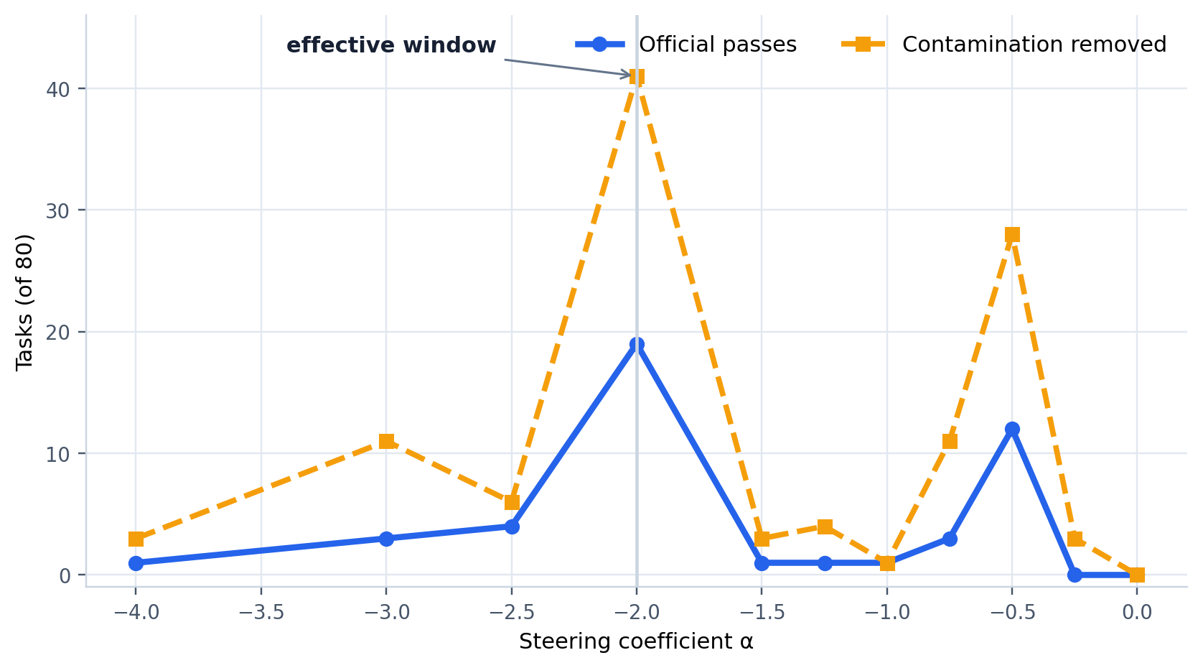
NON-MONOTONICITY
Steering is not a volume knob
Why jagged?
●
Token choice is discrete.
●
One token changes the future context.
●
Future gates then change.
●
Pass/fail is discontinuous.
●
One seed per task adds noise.
DSTK100 · preliminary causal model diffing
18

Slide 17
DIRECTIONAL IMPROVEMENT SCREENING
Base-enriched features reveal a test-generation family
9537
active fraction
7.90
140/215
12883
early max
7.66
139/215
FEATURE 5422
3602
active fraction
7.44
164/215
#4 E/V = -7.25 135/215 base support reverse ROC 0.644 6404: rank #989
5422
active fraction
7.25
135/215
14295
active fraction
7.07
156/215
13397
active fraction
7.04
178/215
15916
active fraction
7.04
136/215
10168
active fraction
6.98
156/215
13801
active fraction
6.94
164/215
12308
active fraction
6.88
145/215
DSTK100 - exploratory improvement-feature audit
17

Slide 18
ACTIVATION TIMING
5422 appears around the transition into generated tests
56
39.2% median first activation 119/119 active 3 in first 10% 28 by first 25%
25
19
16
3
Timing does not prove precedence to the first test marker.
0-10%
10-25%
25-50%
50-75%
75-100%
First activation among 119 contamination improvements
DSTK100 - exploratory improvement-feature audit
18

Slide 19
FEATURE INTERPRETATION
5422 is a literal test-module feature - not a correctness direction
HIGH-ACTIVATION CONTEXT
119/119 contaminations vs 16/96 other improvements Exploratory OR ~ 1,166 Strong detector; causal usefulness untested.
# tests/test_task_func.py import unittest from task_func import task_func class TestTaskFunc(unittest.TestCase):
Dominant tokens: test - tests - / - .py
DSTK100 - exploratory improvement-feature audit
19

Slide 20
IMPROVEMENT TAXONOMY
BigCodeBench improvements contain distinct error mechanisms
Test/import contamination
119
Wrong output / logic
48
119/215 = 55.3% Rule-based taxonomy; manual validation required.
Missing name / import
16
Unexpected value
9
Wrong type
7
Other runtime
6
Wrong API / attribute
5
Truncation / extraction
5
DSTK100 - exploratory improvement-feature audit
20

Slide 21
TOP-10 SEMANTICS
The negative screen decomposes generated tests into sparse components
ID
TOKENS
SEMANTICS
ACTIVE
MEDIAN
9537
_, Test, import
test class/function
119/119
34.2%
12883
#, test, .py
test-block boundary
119/119
14.2%
3602
task_func, import
use inside tests
119/119
36.9%
5422
test, tests, /, .py
test-module path
119/119
39.2%
14295
unittest, assert
unit-test scaffold
118/119
31.6%
13397
task, expected
test expectations
119/119
32.0%
15916
/tests, from, src
test paths/imports
114/119
39.9%
10168
import, class
test-class creation
119/119
38.6%
13801
test, assert, invalid
cases/assertions
119/119
39.2%
12308
import, test, class
test scaffold
119/119
39.9%
Associative features, not yet causally validated directions.
DSTK100 - exploratory improvement-feature audit
21

Slide 22
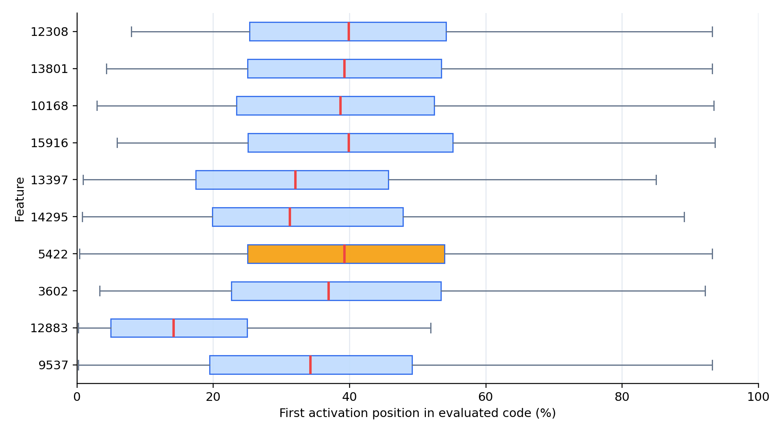
TIMING DISTRIBUTION
Boxplots preserve task-level dispersion across the Top 10
HOW TO READ
Box: middle 50% of tasks Red line: median Whiskers: values within 1.5x IQR Outliers hidden for readability Only active contamination cases
5422 median: 39.2% n = 119/119 active
Position is measured over extraction-v4 evaluated-code tokens; it does not establish precedence to the first test marker.
DSTK100 - exploratory improvement-feature audit
22

Slide 23
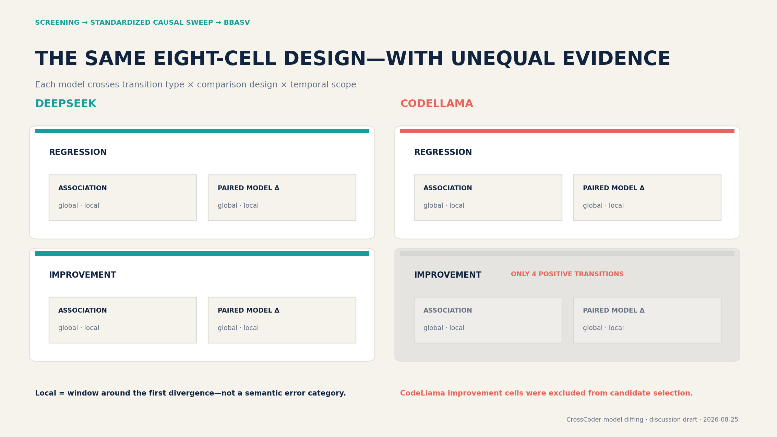

Slide 24
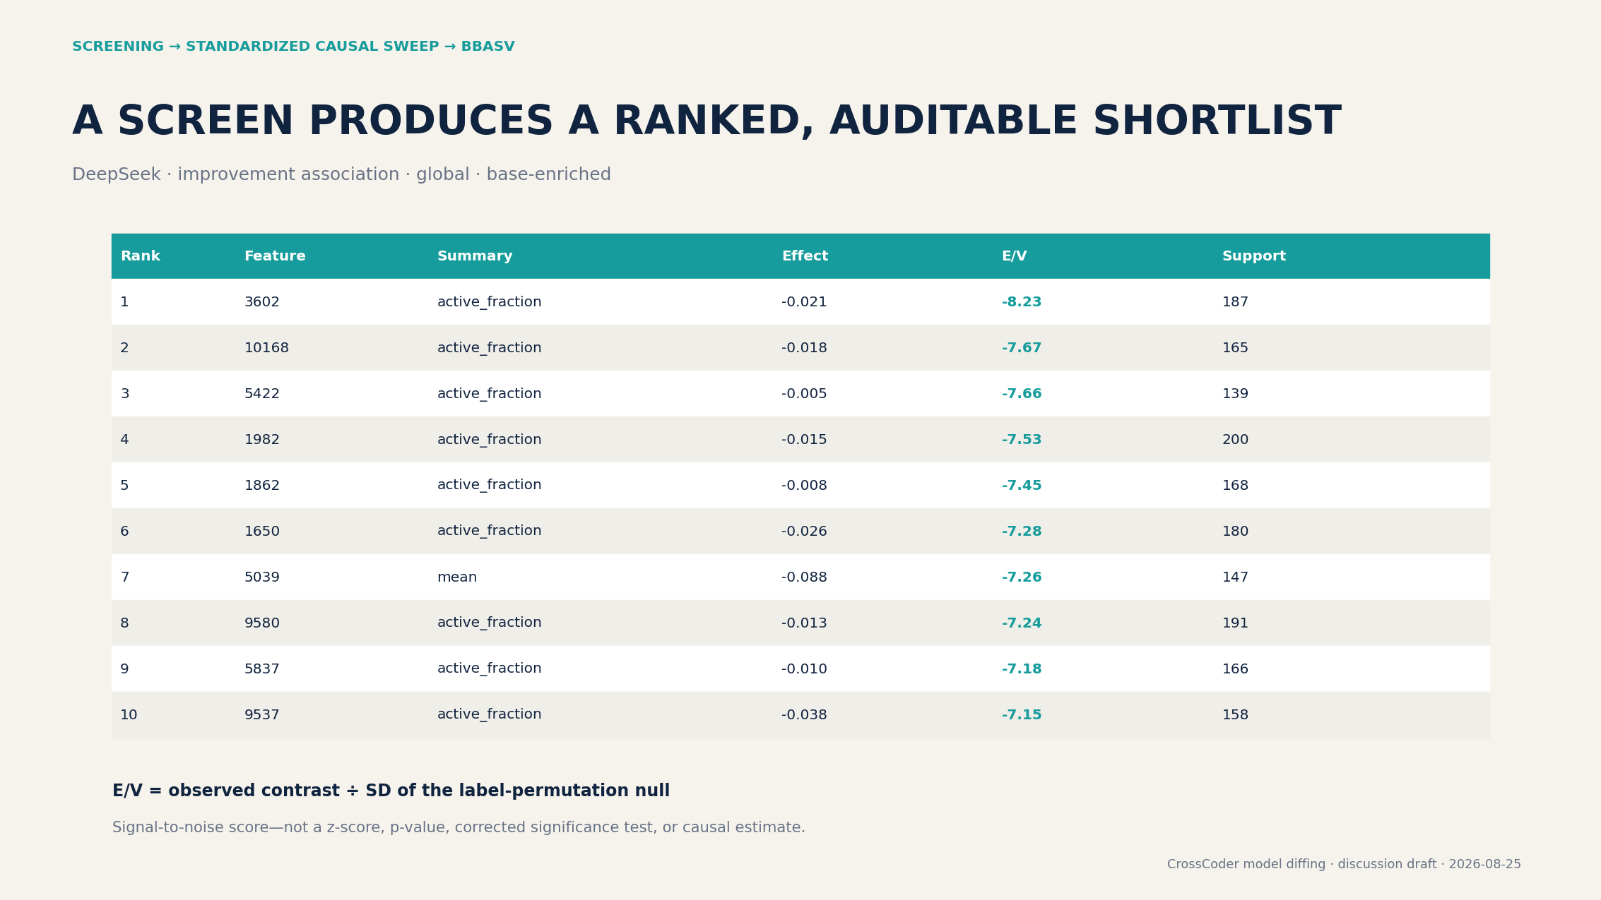

Slide 25
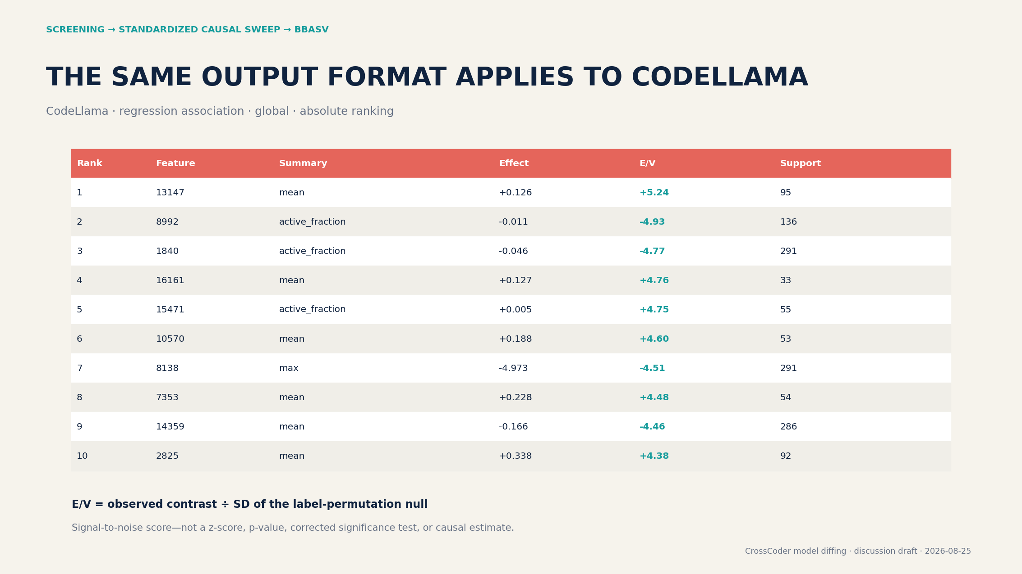

Slide 26
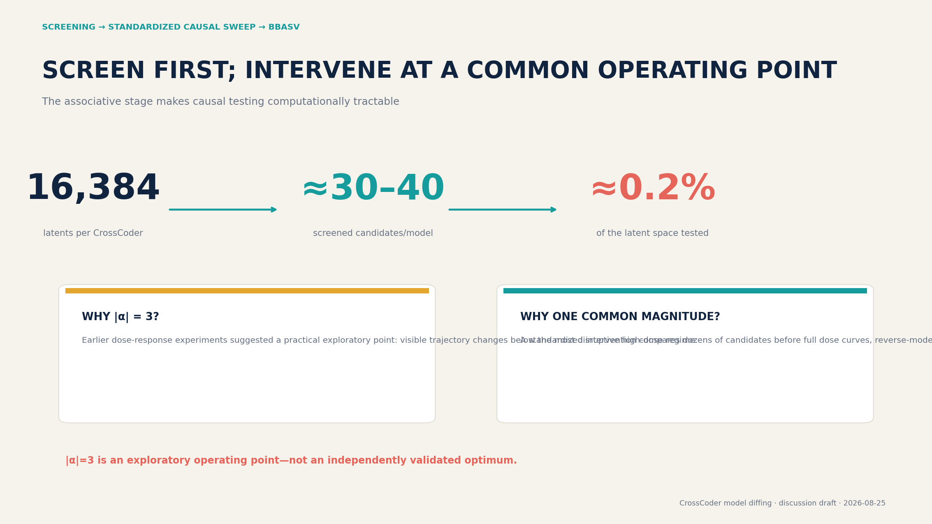

Slide 27
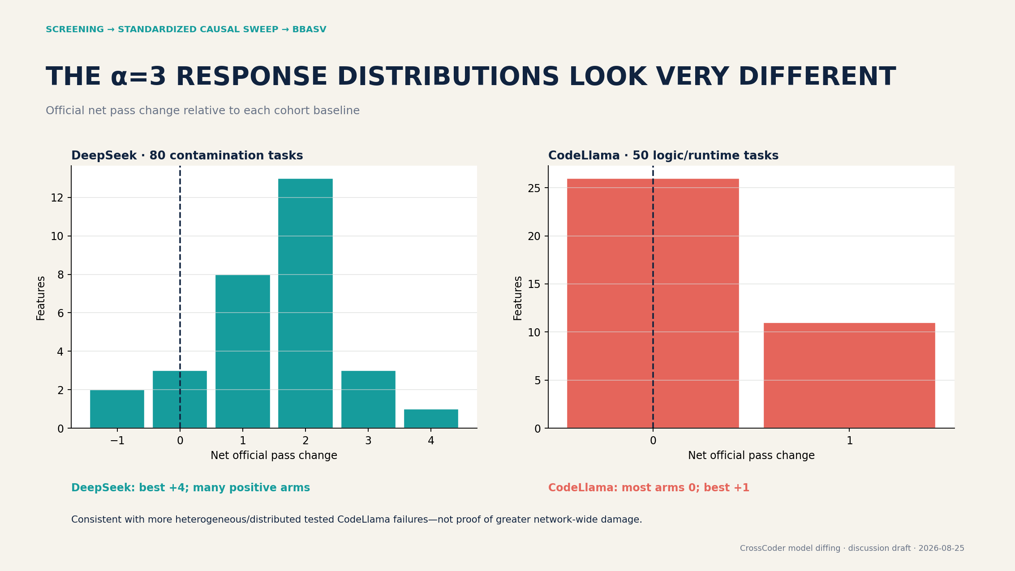

Slide 28
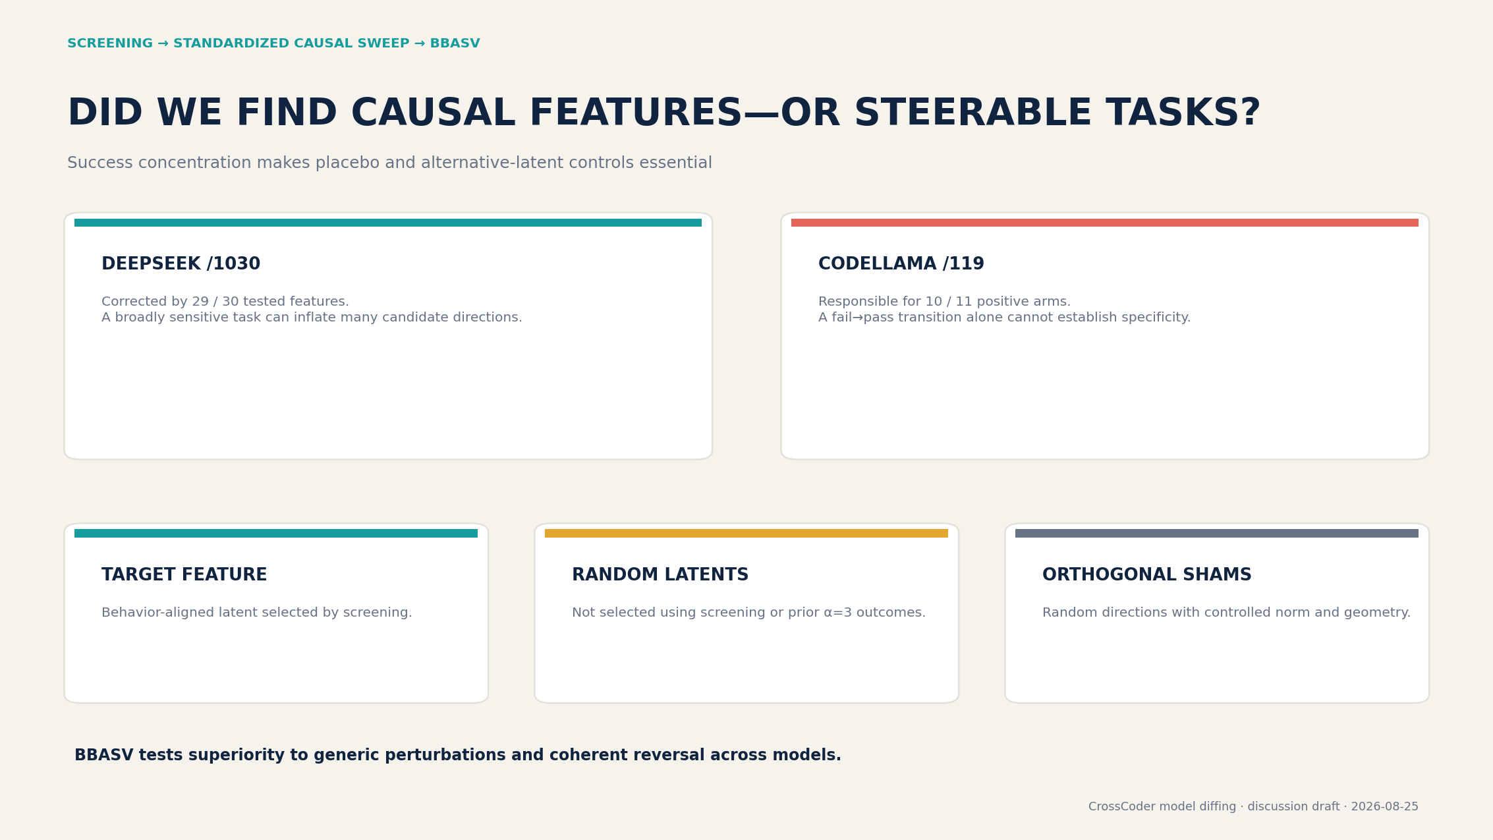

Slide 29
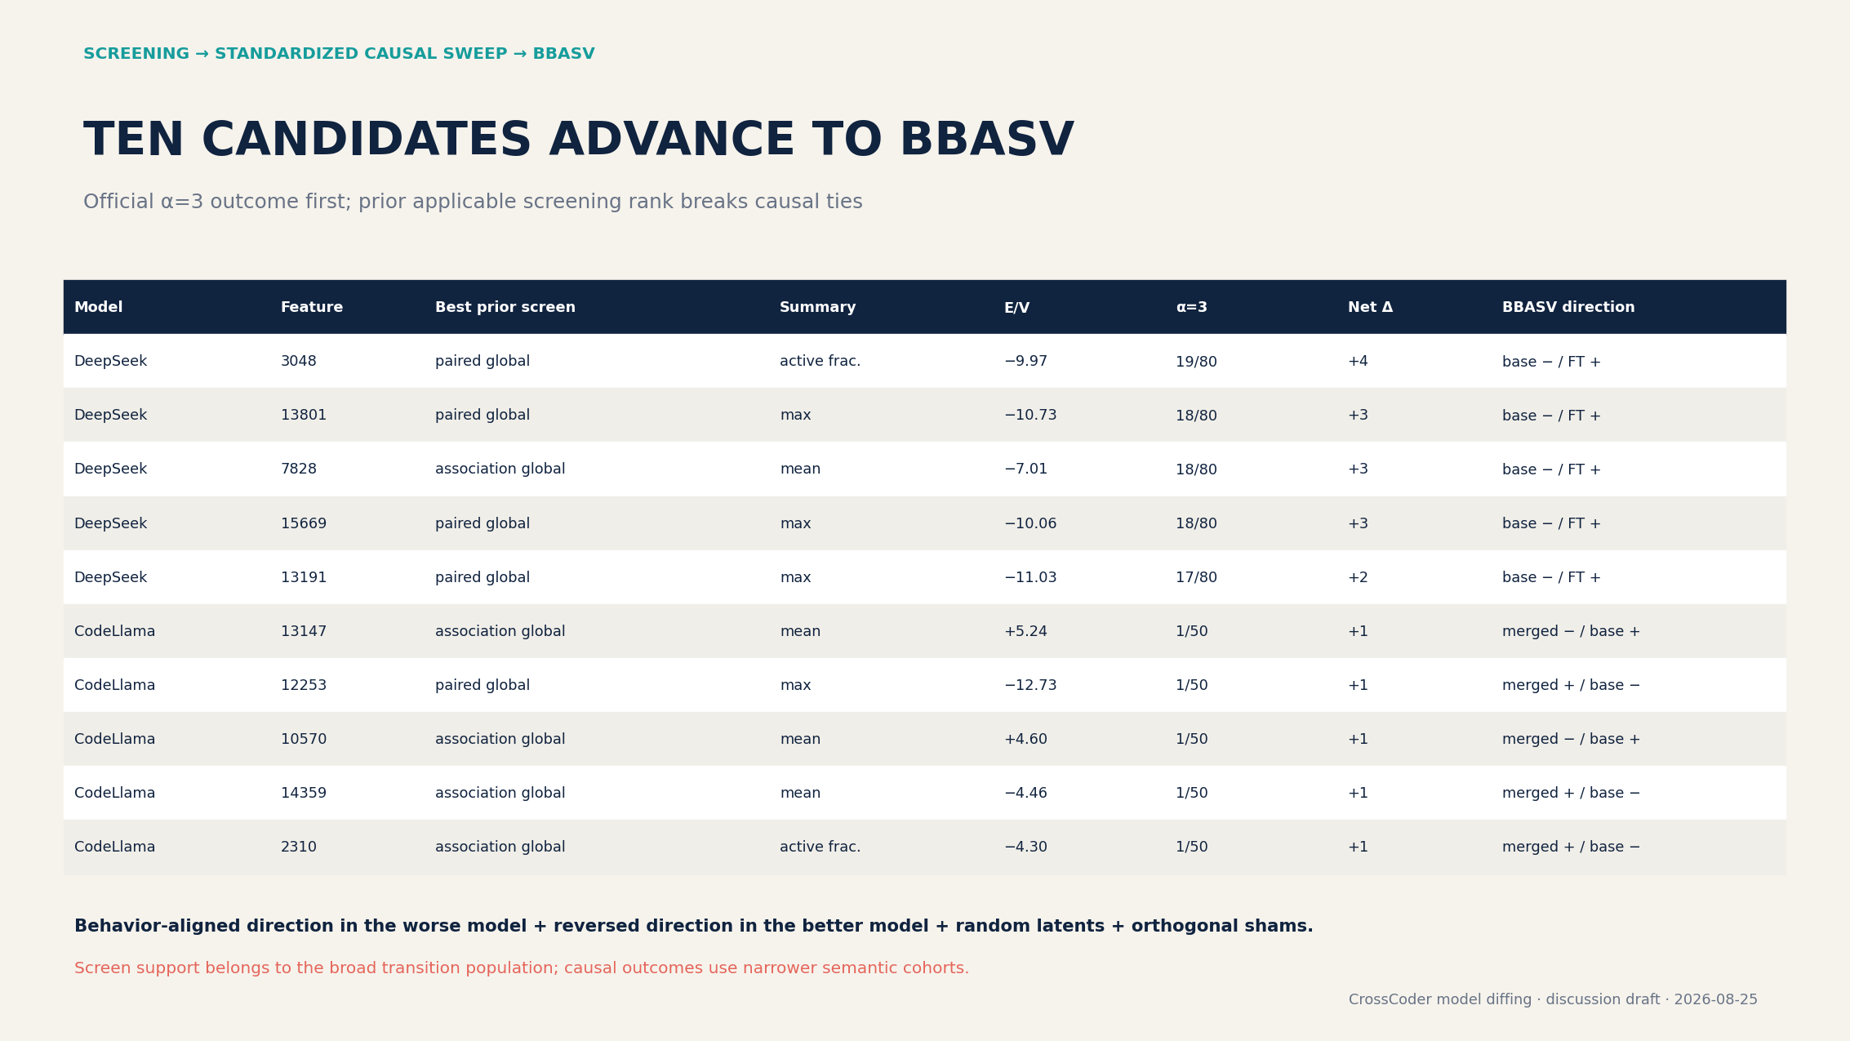

Slide 30
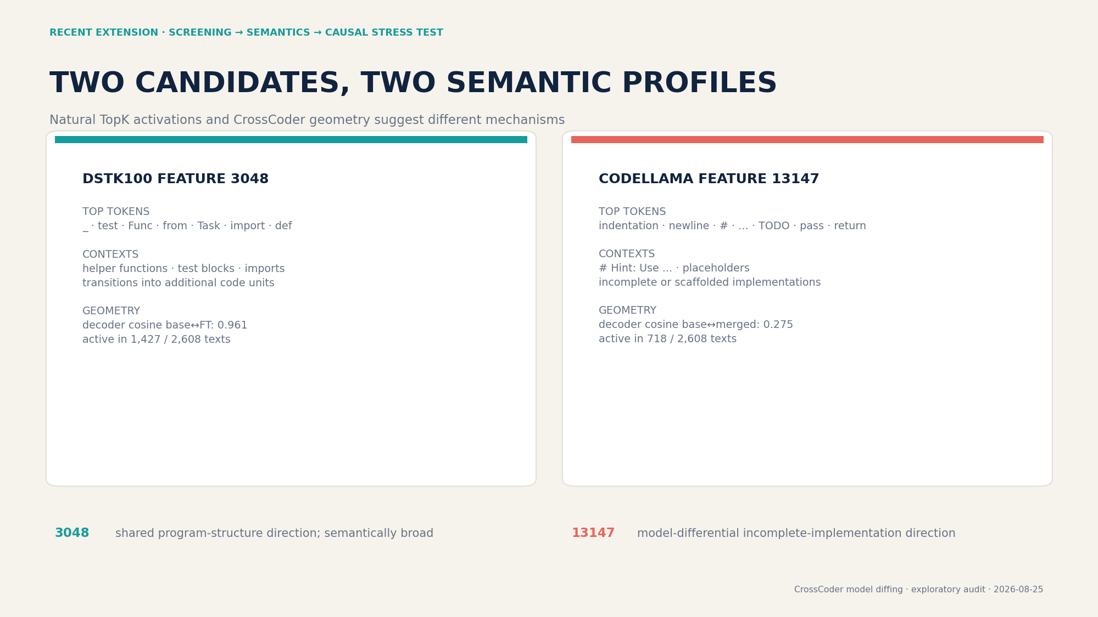

Slide 31
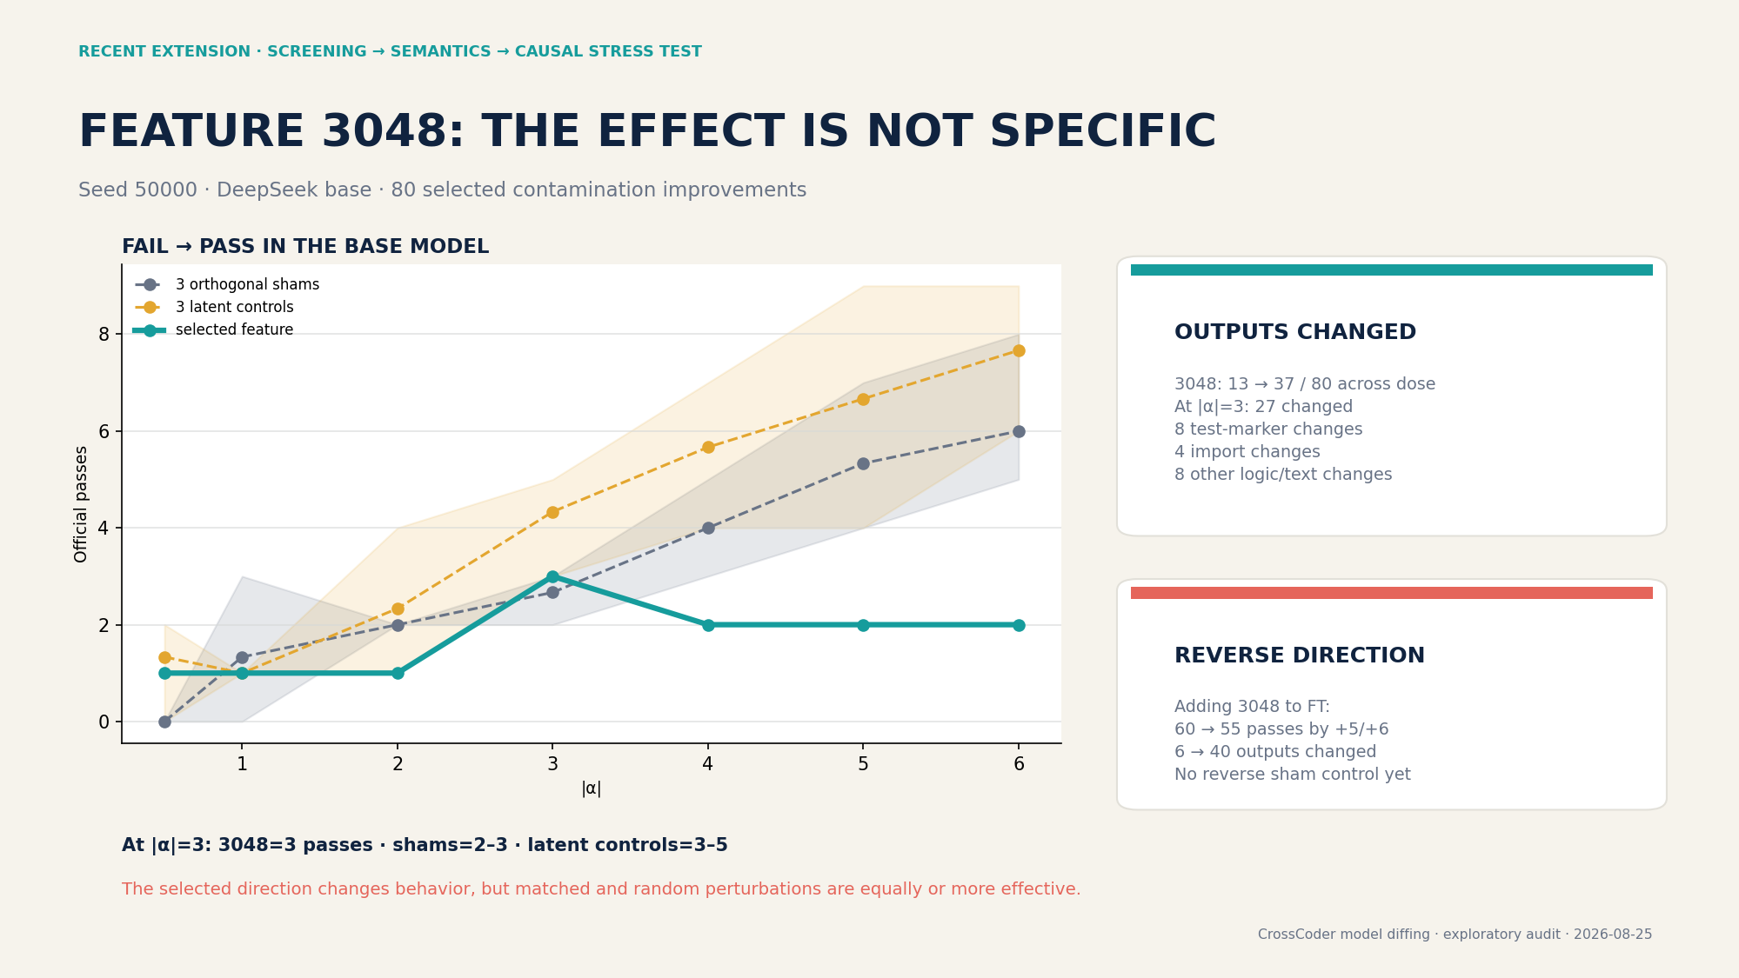

Slide 32
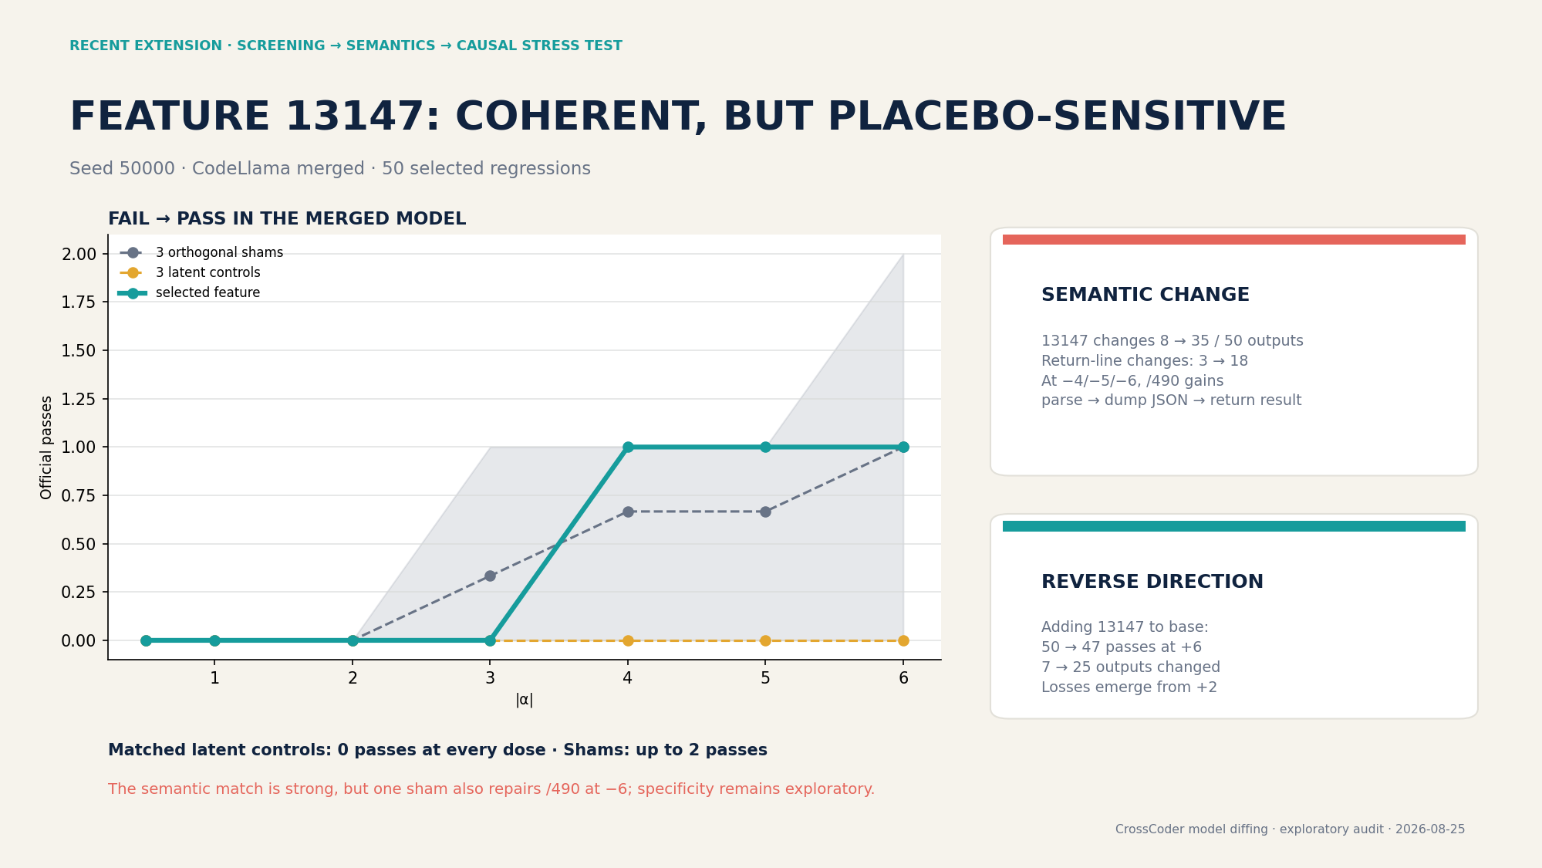

Slide 33
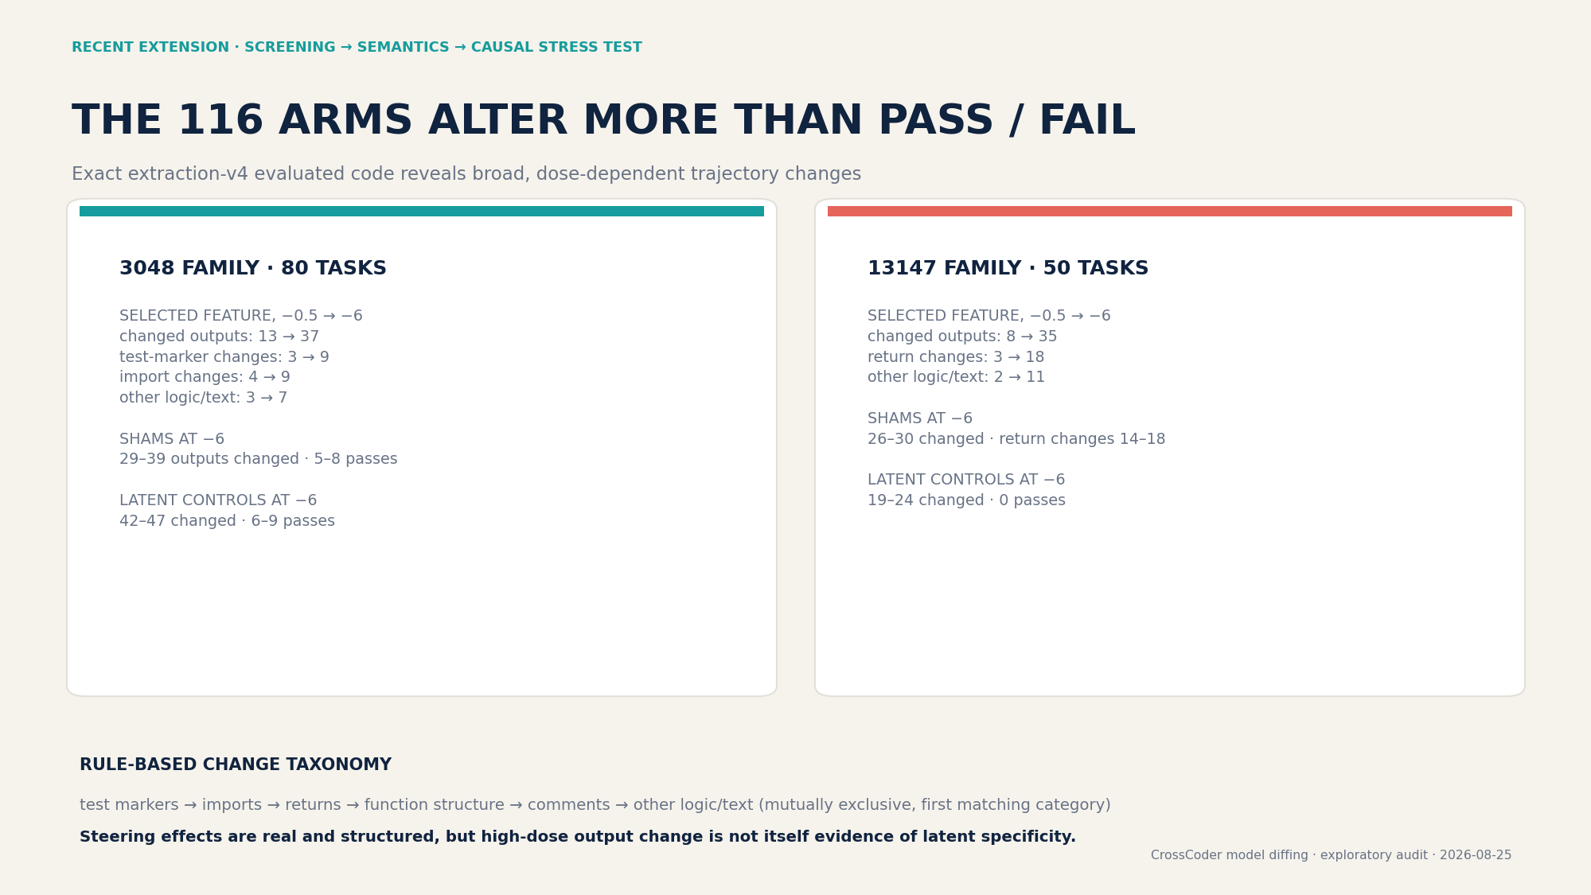

Slide 34
